Slide 1


Slide 2



Professional Modes of Communication

Slide 3

Using Digital Communication Technologies
Use of online tools such as email, social media texting, etc. to communicate and talk with other people.
Faster than old communication technologies such as fax machines, telephones, letters, etc.

Slide 4
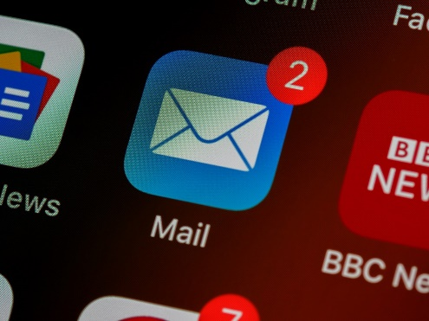




Modes of Online Communication
Emails
Social media
VoIP (Voice Over Internet Protocol)
Video conferencing
Online forums
Notes:
Voice over Internet Protocol, also called IP telephony, is a method and group of technologies for the delivery of voice communications and multimedia sessions over Internet Protocol networks, such as the Internet.

Slide 5
Advantages of Online Communication
Cost-Effective
Globalization
Improved Productivity and Efficiency
Easily Accessible
Convenience and Ease
Notes:
Cost-Effective
Online communication and web conferences are cost-effective in every possible way as compared to a physical conference. To join a physical conference, not only does one have to spend money to travel but also the cost of food and staying are also there along with other expenses, whereas, with an online video conference all you need is a computer or a mobile phone that has a working internet connection and that is it.
Convenience and Ease
Gone are those days of the past where the internet connection was never stable and it was impossible to even have an audio call over the internet. Internet technology has evolved and improved so much that flawless internet connectivity is now available in almost every part of the world. This makes it easier to use online conferencing services for business and personal purposes since the connection is always stable and flawless.
Easily Accessible Through Any Device or Platform
The thing about online video conferencing is that you can do it online on any device. Whether you are on a computer, a tablet, or a smartphone, you can easily do online conferencing through any device as long as it has support for the internet.
Improved Productivity and Efficiency
For businesses, productivity and efficiency matter a lot. The efficiency of a business depends more or less on the ease of communication and smooth transition of information among the employees. Although most of the interaction between the employees occurs through memos and emails, video conferencing can be a better alternative to these. Through video conferencing, employees working at different levels can see each other in real-time and communicate about different things to collaborate on an ongoing project, real time sharing of documents.

Slide 6
Disadvantages of Online Communication
Requires a high speed internet access
Interpersonal skills
Misinterpretation
Connectivity issues
Ineffectiveness

Slide 7
Email Etiquettes
What is etiquette?
The rules which indicate the “correct” way to behave in a certain time and place.
Email etiquette is especially important in the work place

Slide 8


6 BASIC EMAIL ETIQUETTE RULES

Slide 9
Rule #1: Always include a subject and use the recipient’s name in the greeting
Why is a subject important?
It informs recipient what the email is about.
Make it short and to the point, i.e.: “Fee Waiver Question” or “Admission
Requirements”

Slide 10
Rule #2: Do not write in ALL CAPITALS
WRITING IN ALL CAPITALS CAN CONVEY THAT YOU ARE SHOUTING IN YOUR MESSAGE, AND NOBODY LIKES TO BE YELLED AT. CONSIDER OTHER WAYS TO GET YOUR MESSAGE ACROSS WHILE CONVEYING ITS IMPORTANCE. USING ALL CAPITALS CAN BE ANNOYING AND TRIGGER AN UNINTENDED RESPONSE.

Slide 11
Rule #3: Greetings!
Always begin your email with a proper greeting: Dear Eliza Jones,
Ms. Jennifer Professor Carter.
This establishes the tone of the message and respect for the recipient
If emailing a department or office, use “to whom it may
concern:” as such emails are often read by an office assistant before being forwarded to the appropriate individual.

Slide 12

Rule #4: Do not use email to discuss confidential information

Slide 13

Rule #5: Take care with abbreviations and emojis ☺
Save abbreviations like LOL (laugh out loud) or IDK (I don’t know) for text messages among friends.
Some may not understand your abbreviations
Not professional

Slide 14
Rule #6: THINK before you send
If you answer yes to all of these questions:
Is this relevant to the work my organization is doing?
Will the office benefit professionally from this information?
Okay to send!

Slide 15
But if you answer NO to any of these…
Could this information hurt/embarrass/offend someone?
Email should not be used for confrontation/yelling/reprimanding
Could this email be misinterpreted in a bad way?
Is this information important to share in the workplace?
Could this email get me into trouble?
Do NOT send!

Slide 16
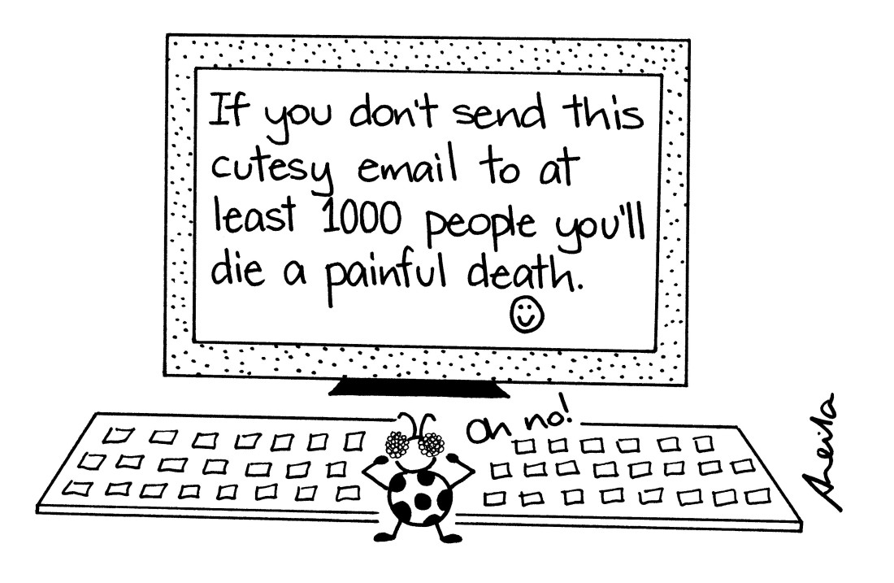
Rule #7: Do not Forward unnecessary/unrelated Emails

Slide 17
Grammar, Spelling and Punctuation
Always reread your email a few times to find grammatical and spelling errors
Spell check: all email accounts should come with this feature. Use it!
Avoid using all capital letters which may come across as yelling. “How are you?” Is much more professional than “HOW ARE YOU?”

Slide 18
Forwarding
Is it a good idea to forward emails that promise money or goods?
Should you forward emails to as many contacts as possible?

Slide 19
Rules for Forwarding
Think carefully about if what you are forwarding will be of value, appreciated or humorous to the person on the other side.
If an email tells you to “Forward to everyone you know/love/all of your family” do NOT forward

Slide 20
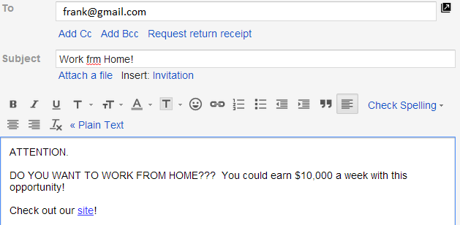
Example 1: Would this email be relevant to someone?

Slide 21
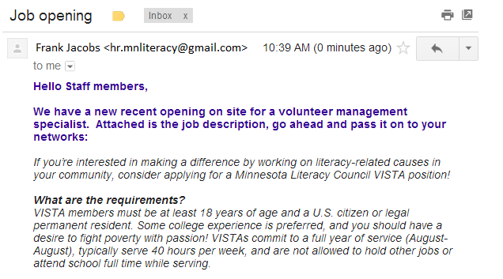
Example 2: Would this email be relevant to someone?

Slide 22
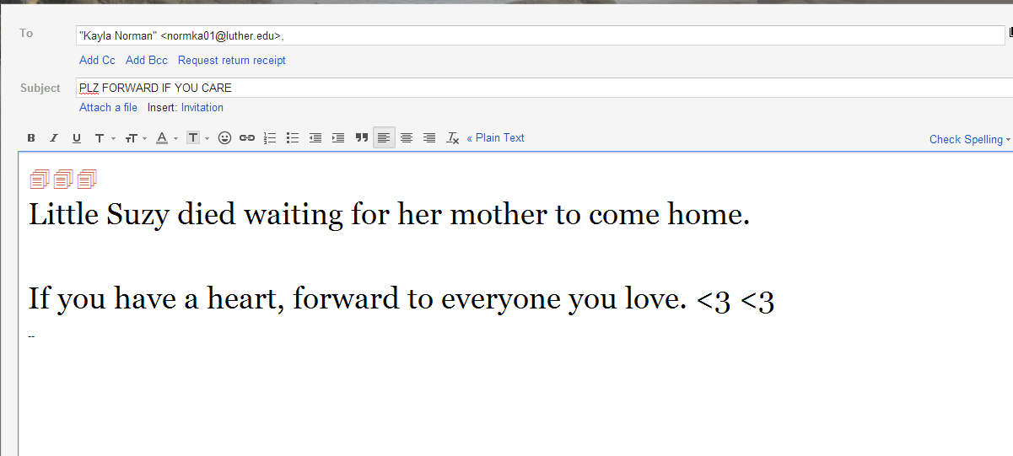
Example 3: Would this email be relevant to someone?

Slide 23
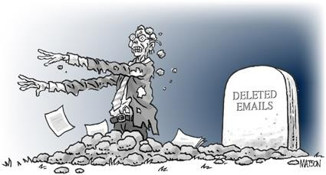
REMEMBER: When you send an email to someone, they are getting a copy that they can keep…forever.

Slide 24
Be Mindful of your email address
rockerboy113@yahoo.com is fine to use with friends but NOT to staff at high schools, colleges, businesses or any person you do not personally know.
Create a new address like jdoe@gmail.com or jd@yahoo.com
“Remember, simple and professional. No numbers, nick names
or references to cartoon characters…”

Slide 25
CC VS BCC
To: If you are creating a message, you may put in one or more e- mail addresses separated by commas.
Cc: Send people courtesy copies.
Bcc: Send a "blind" copy to another person. The "To" and "Cc" people won't know. If you are sending a group of people and don't want everyone to see the addresses, enter them as Bcc.
From: Tells you the name and Internet address of the person who sent the message.

Slide 26
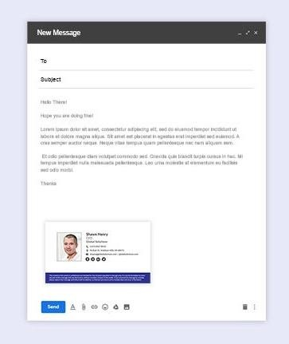
Add Signatures
Signatures can be formal information about yourself.
May include personal information.
Company phone number, email address, postal address.
Personal phone number, email address, postal
address.

Slide 27
That’s it!

